Slide 1
Wind Turbines
File created on: 1/27/2022 6:48:11 AM

Slide 2
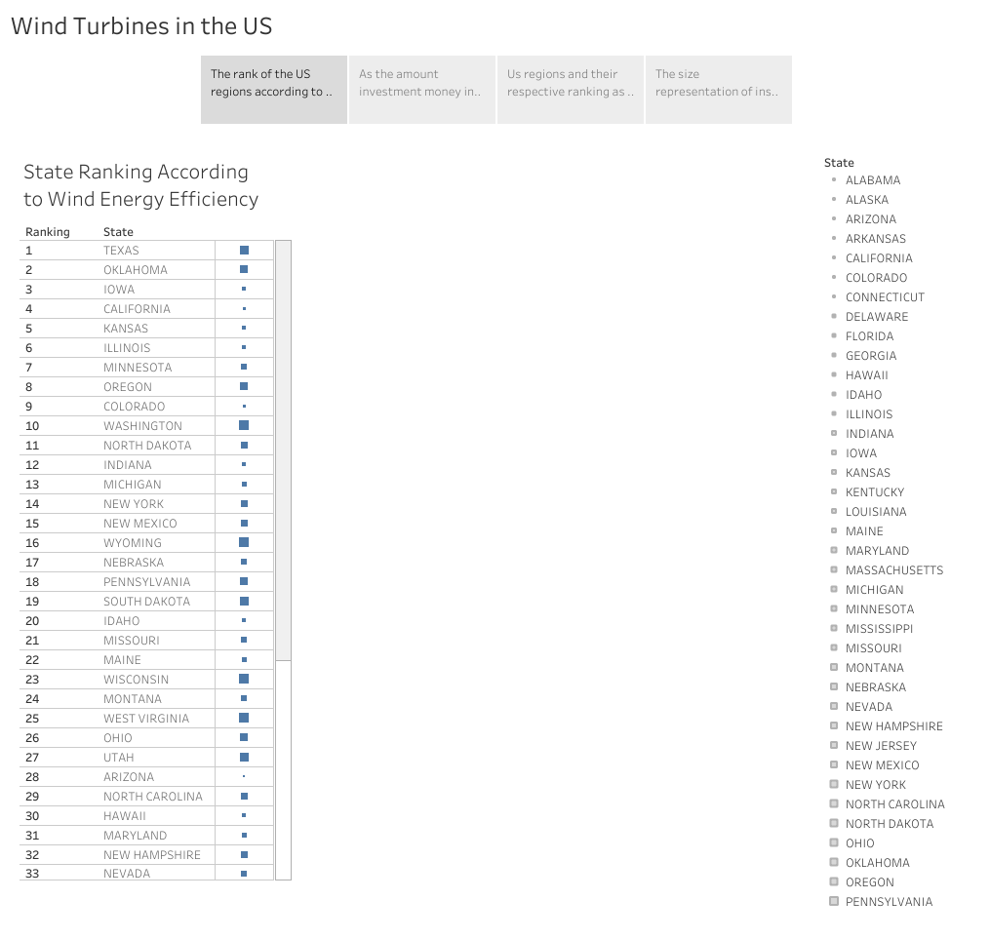

Slide 3
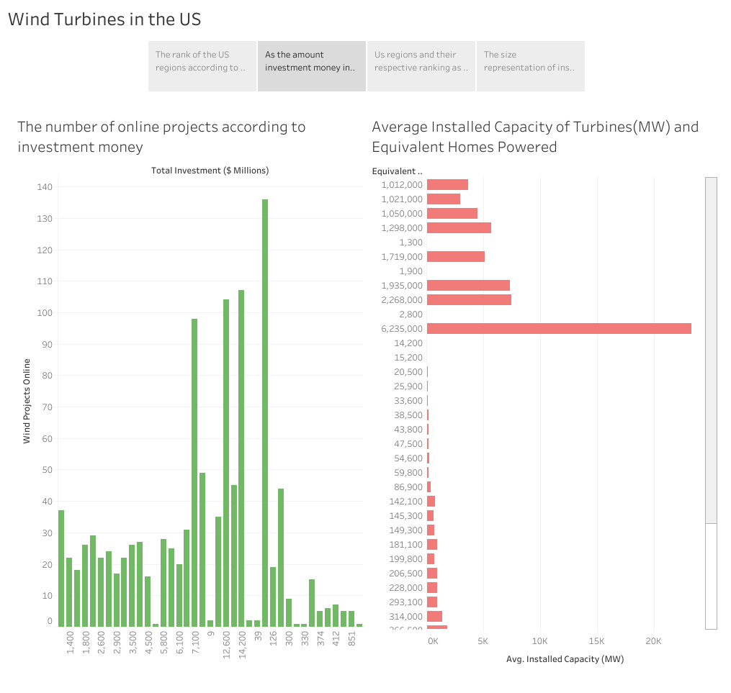

Slide 4
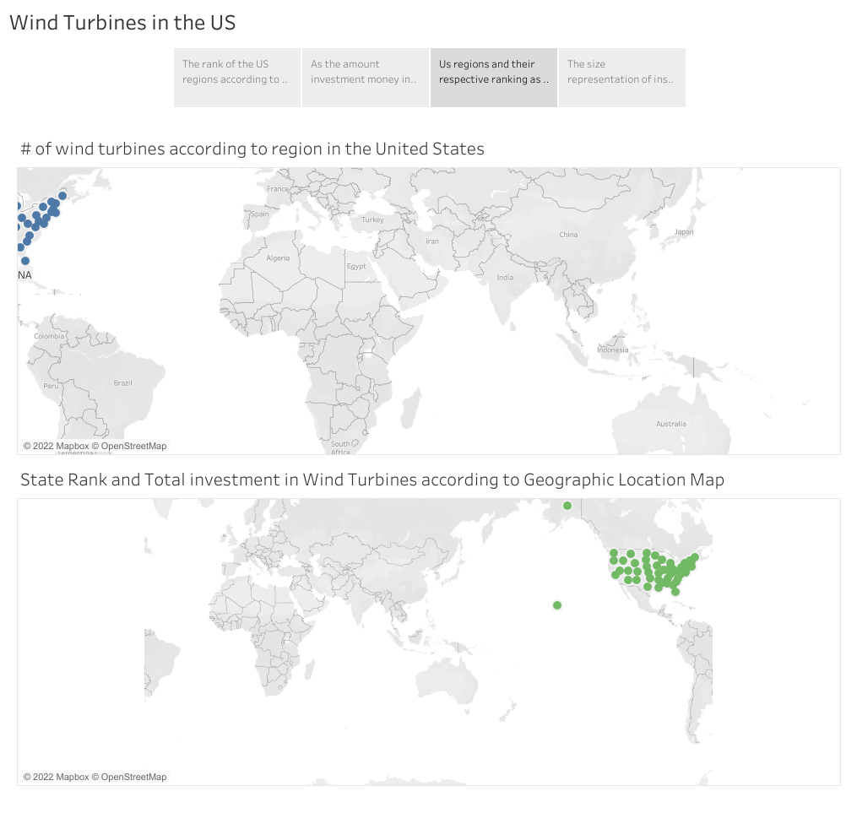

Slide 5
